Slide 1

Gullah Culture and the Music of Lowcountry South Carolina & Georgia Sea Islands
“Island Life” By Saundra Renee Smith
Mariana Mathewson
World Music Pedagogy
June 1st, 2020

Slide 2
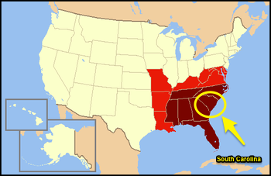

Slide 3


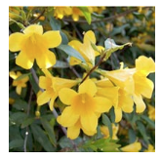
South Carolina Facts
Estimated population – 4,774,839 (2013, 24th largest state)
Capital City: Columbia
Town with smallest population – Jenkinsville - 45 (2012)
History
  Named after King Charles I in 1629
  First English settlement was named Charles Town in 1670 and later became known as “Charleston”—went on to become one of the most prominent ports in the southern U.S.
  Split from North Carolina in
  Was the first state to secede from the Union in 1860
Leading agricultural products – Broilers, turkeys, greenhouse nurseries, cotton, corn, cattle, soybeans, peanuts, eggs, and wheat (2015)
“The Palmetto State”
State Flower: Yellow Jessamine
https://www.sciway.net/facts/

Slide 4
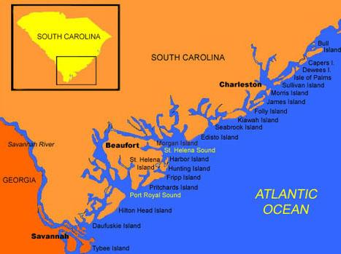
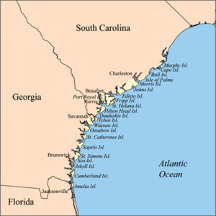
Where are the Sea Islands?

Slide 5
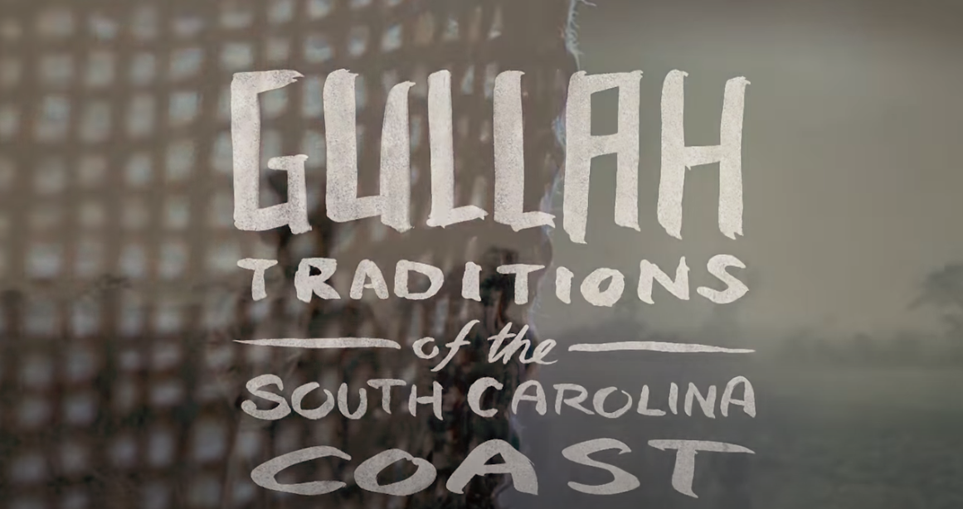
What is ”Gullah”?
Video from Beaufort Historical Culture Website

Slide 6
The Atlantic Slave Trade
The Atlantic slave trade: What too few textbooks told you - Anthony Hazard

Slide 7
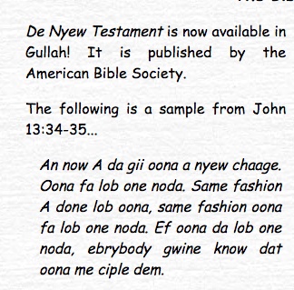
Gullah Language
Gullah is a “creole” language meaning that it evolved by mixing English with the native languages of the slaves that were brought to work on the plantations.
Most of the vocabulary is derived from English, but there are some words that have African origins.
  Example: oonuh ("you [plural]"), nyam ("eat"), buckruh ("white man"), pojo ("heron"), swonguh ("proud") and benne ("sesame")
Today, Gullah is spoken by about 5,000 people in coastal South Carolina and Georgia
Has been stigmatized for a long time, often associated with “uncultured” or “uneducated speech.”
  Has been revitalized over the last 20 years and more people are speaking it, learning it, teaching it, and promoting its cultural importance.

Slide 8
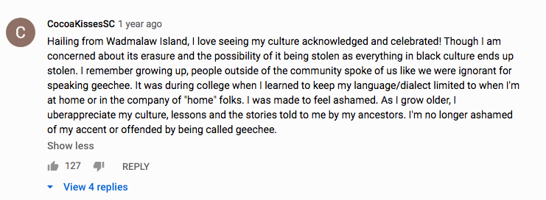
A voice from the Gullah Community

Slide 9

Sound clip of Queen Marquetta Goodwine singing and speaking at a cultural advocacy event in North Carolina

Slide 10
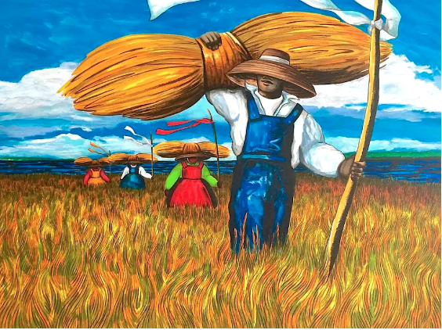
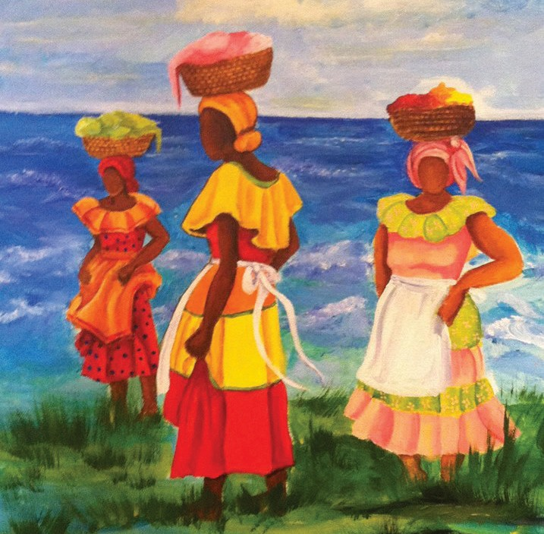
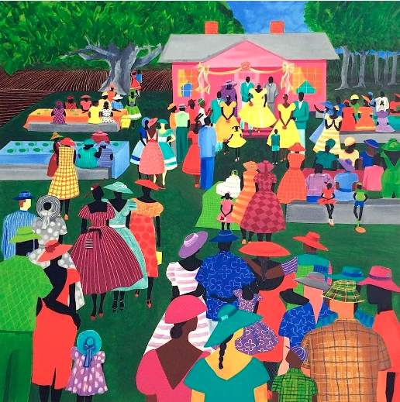
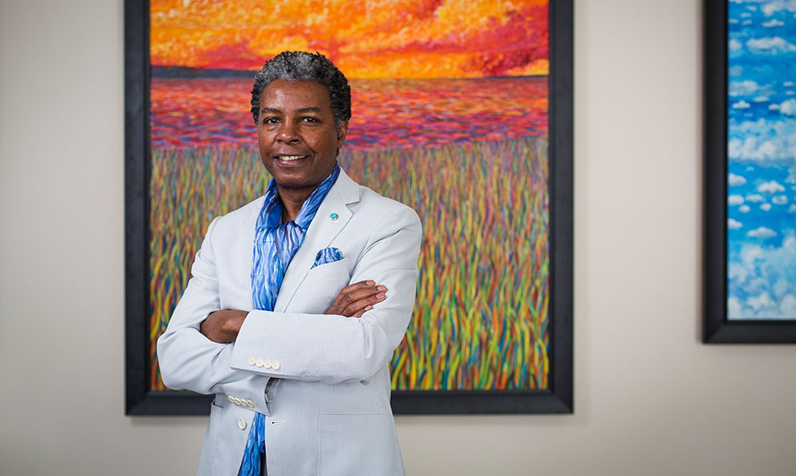
Gullah Visual Art
“Sweetgrass Carriers” by Jonathan Green
Artist: Diane Britton Dunham
“The Reception” by Jonathan Green

Slide 11
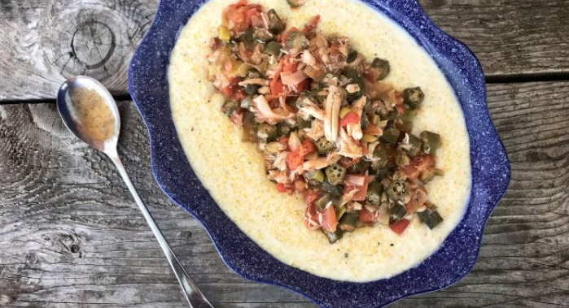
Gullah FOOD!
Dr. Howard Conyers, in collaboration with NOURISH and PBS
Red Rice
Seafood Stew
Tomato and Crab Gravy over Grits
Charlotte Jenkins, Gullah Cuisine chef-owner
Right: Okra Soup

Slide 12
Gullah/Geechee Music
“Little Johnny Brown”, “Talkin’ Bout a Good Time”, “That’s Alright”

Slide 13
Ring Play: “Little Johnny Brown”
Listen to the recording a few times and practice the refrain as a group.
Make a circle in the middle of the room.
Player One stands in the middle of the circle. Player has to follow the circle’s instructions.
Lead Voice will sing the instructions, and group voices will sing “Johnny Brown” response
Instructions Go Like this:
  Lead + Group Little Johnny Brown, Lay that Comfort down (x’s 2)
  Lead begins giving instructions

Slide 14
How to Play
LEAD VOICE:
Fold one corner,
Fold another corner
Fold another corner
Fold another corner
Take it to your buddy,
Take it to your buddy
Show them your motion
Show them your motion
Lope like a buzzard
Lope like a buzzard
Give it to your buddy,
Give it to your buddy
Give it to your buddy
GROUP VOICE:
Always repeat: “Johnny Brown”
Player folds one corner of handkerchief to middle
Repeat
Repeat
Repeat until all 4 corners are folded down
Player takes folded handkerchief and takes it to another player in the circle
Player busts a sick dance move (“their motion”)
Player leads the circle in buzzard motion
Player then returns to their original spot in the circle and the player with the handkerchief is the new player one

Slide 15
Attentive Listening: “Talking Bout a Good Time”
Guiding Questions
Are there any instruments in this song?
Listen to the lyrics. What words are repeated?
What kinds of sounds are driving the rhythm?
(Older students) What words are emphasized or seem important?
(Older students) how many layers of rhythm are in this piece?

Slide 16
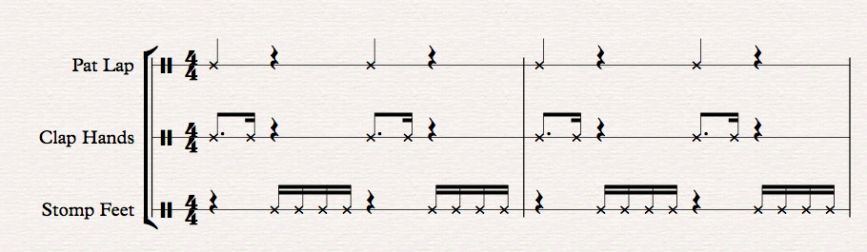
Engaged Listening: “Talking ‘Bout a Good Time”
Intro of Clip (4 bars) pat your lap on beats 1 & 3
Rest of Clip Clap the following rhythm:

Slide 17
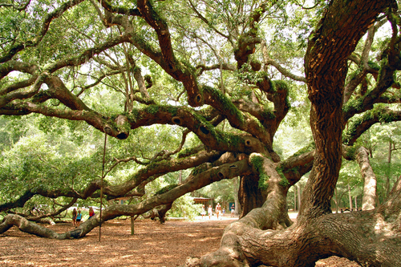
That’s Alright (Since I know I got a seat up in the Kingdom)
John’s Island, South Carolina

Slide 18
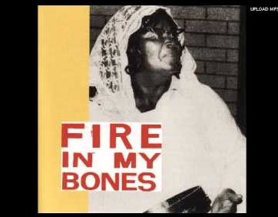
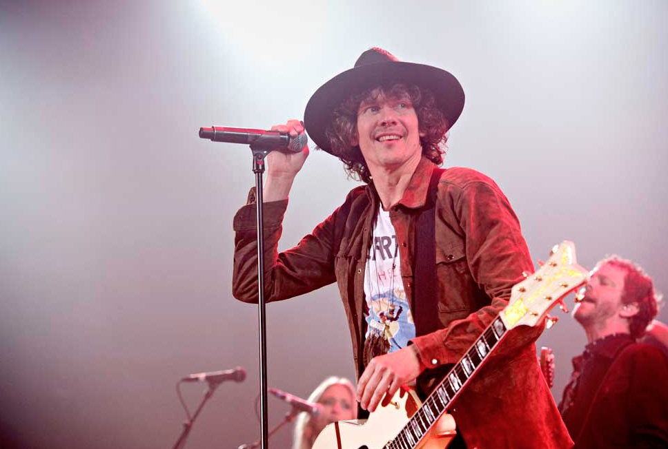
Attentive Listening
Original recording: Laura Rivers,
John’s Island, South Carolina early 1960’s
Version by Hålkan Hellström, Sweden (2016)

Slide 19
Attentive Listening: Ranky Tanky Version
Ranky Tanky - "That's Alright" - Luck Highwater Sessions
Guiding questions:
  What elements of the music have been changed in this version?
  How many people of color do you see in the audience?
  What is the behavior of the audience? Are they an active or a passive audience?
  How does this version make you feel as compared to the original? To Hellstrom’s version?

Slide 20
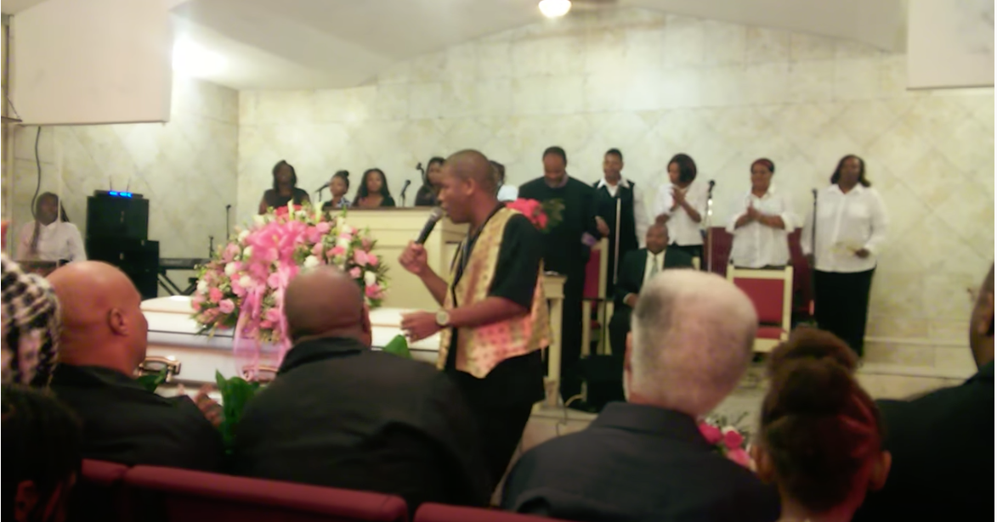
Field Recording: Khalil White
That's Alright Since I Know I Got A Seat In The Kingdom - Kahlil White
Guiding questions:
  What elements of the music have been changed in this version?
  How many people of color do you see in the audience?
  What is the behavior of the audience? Are they an active or a passive audience?
  How does this version make you feel as compared to the original? To Hellstrom’s version? To Ranky Tanky’s version?
  Was there anything about this video that surprised you?

Slide 21
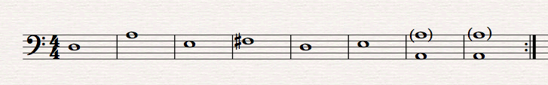
Enactive Listening: Bass line
As cellos/basses play the bass line, sing the chorus of the song with Ms. Mathewson a few times.
Directions to play: Outside stand players will play arco while inside stand players will play pizzicato.

Slide 22
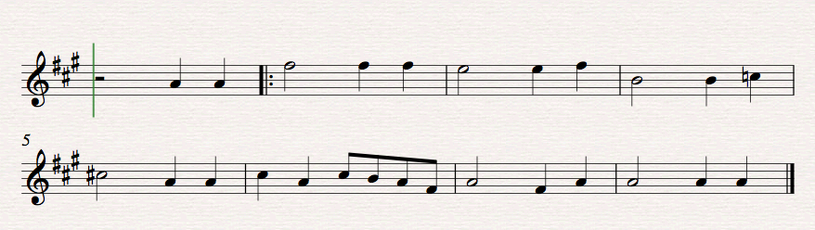
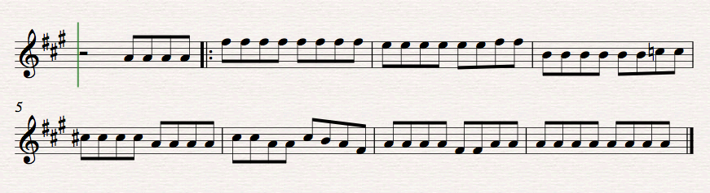
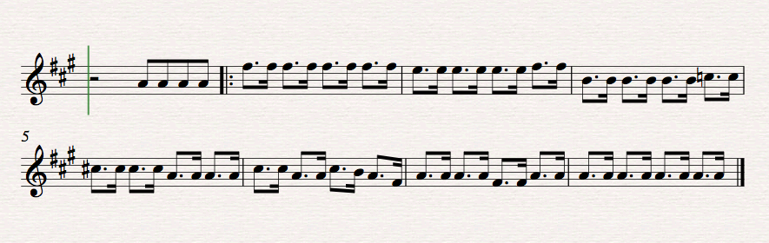
Creating: Let’s Improvise!
Cellos and Basses continue to play bass line.
Violins/Violas will play through the melody
  Experiment with different rhythms—for example, all first violins will change the melody to eighth notes

Slide 23
Creating: A Reassuring Song Verse
The song “That’s Alright” has this kind of structure for the verse:
  Hush lil' baby, Don't you cry,
  You know your mother been born to die,
  Since my soul's got a seat up in the kingdom
  that's all right.
  (AABC)
Fill in the blanks: __________________________, _________________________, Since my soul's got a seat up in the kingdom that's all right.

Slide 24
Creating: Going Further
Up to this point, we’ve looked at songs that serve three main purposes:
  Communicating Directions
  Story Telling
  Reassuring/Comforting
Come up with some song ideas for one of the three categories.
  What kind of story would you tell in a song?
  What’s a task with instructions that would make a good song?
  How would you reassure someone through a song?
Notes:
Three main points:
Distinctive Culture
Lessons for younger grades
Lessons for high school (and beyond!)

Slide 25
Questions?
marianathecellist@gmail.com
Thanks for coming along on the journey with me!

